Slide 1
Lesson 9
E115 – Programming and Data analysis

Slide 2
Lesson objectives
At the end of the lesson, you should be able to:
Declare and initialise one-dimensional and two-dimensional arrays
Use “For Next” loop and “Do While” loop to access elements of arrays

Slide 3
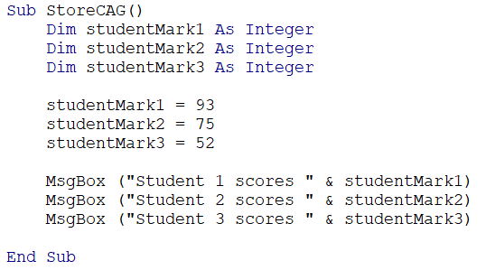

Arrays
An array is a group of elements of the same type that have a common name.
Imagine you want to write a program to store 3 students’ MSA marks and show in message box. Would you do this?
What about storing 300 students’ marks?

Slide 4

Arrays
We can use array to store the students’ marks instead of creating individual variables.
For 300 students, we can create an array of 300 elements.
Location 0
3 elements in the array. All are the same data type (i.e. integer)
0
1
2
93
75
52
Put 93 into Location 0 of the array “studentMarks”

Slide 5

Exercise 1
a) Declare an array named Country to store all the 10 ASEAN country names from location 0 to 9.
Answer:
b) Set the 3rd element in the array as “Laos”, and last element in the array as “Singapore”
Answer:

Slide 6
How to declare array?
These are different ways to declare an array:
Location 0 to 5 → Total number of elements in array is 6
Location 0 to 5 → Total number of elements in array is 6
Location 1 to 5 → Total number of elements in array is 5
Location 2 to 4 → Total number of elements in array is 3

Slide 7
LBound(Array) and UBound(Array)
0
1
2
93
75
52
LBound stands for “Lower bound”, UBound stands for “Upper bound”
LBound(Array) is to get the 1st location of the array.
e.g. LBound(studentMarks) = 0
UBound(Array) is to get the last location of the array.
e.g. UBound(studentMarks) = 2

Slide 8
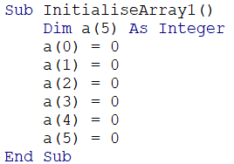

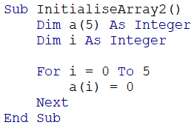
Initialise array
How do we set all the elements in an array to 0?
Method1: We can initialize each element one by one
Method2: We can use a loop to initialize all the elements.
Which one do you prefer?

Slide 9
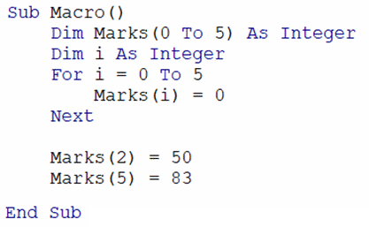
Question
Analyse the following codes:
Question: What value is stored in Marks(3)?
→ 0
Use a For Next loop to set everything in the array to 0
Assign Location 2 element to value 50
0
1
2
3
4
5
0
0
50
0
0
83

Slide 10
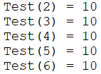
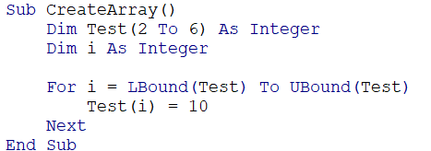
Exercise 2
Use a “For Next” loop to set all the elements of the array Test to contain the following values:
Answer:

Slide 11
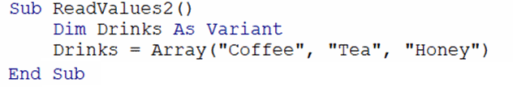
Variant Array
Alternatively, we can also do the following to let Excel automatically create the number of locations based on the specified values.
Store these 3 items in an array named “Drinks”
After the code runs,
Drinks(0) contains “Coffee”.
Drinks(1) contains “Tea”.
Drinks(2) contains “Honey”.

Slide 12
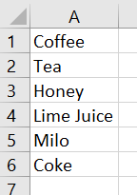

Variant Array
We can also grab values from a range and store them into a variant array.
Example: To read the values from A1:A6 and store in an array:
Excel auto create the number of locations in Drinks based on the number of cells in the specified range
After the code runs,
Drinks(1,1) contains “Coffee”.
Drinks(2,1) contains “Tea”.
Drinks(3,1) contains “Honey”.
Drinks(4,1) contains “Lime Juice”.
Drinks(5,1) contains “Milo”.
Drinks(6,1) contains “Coke”.

Slide 13
Two-dimensional array
Similarly, we can declare a two-dimensional array like this:
This means there are 5 rows and 6 columns in the array, i.e. 30 elements in MyArray in total.
You can also specify the Location of the rows and columns like this: which means there are 3 rows (Location 1 to 3) and 9 columns (Location 0 to 8) in MyArray2.

Slide 14
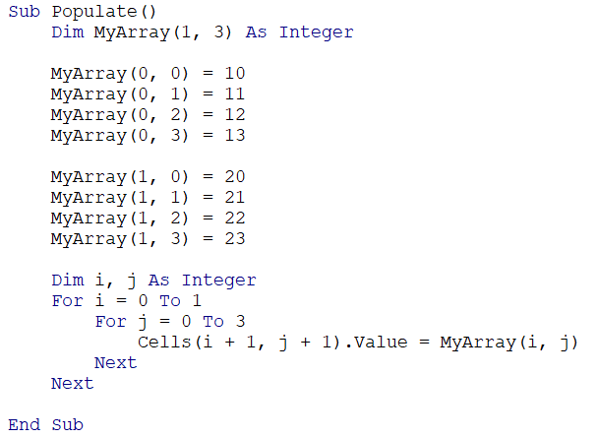

Do it with me
Copy the following codes and see what happen in your excel sheet:
Because there is no Cells(0,0)
Why need to use i+1 and j+1?

Slide 15
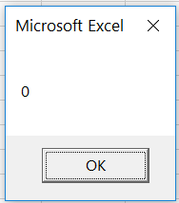
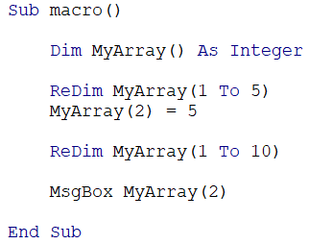
Dynamic Array
Sometimes you might not know the size of the array beforehand. Hence we use ReDim to redeclare the size of the array.
Type the following codes and see what the value is in Location 2.
Every time we use ReDim, all the values in the array are erased.

Slide 16
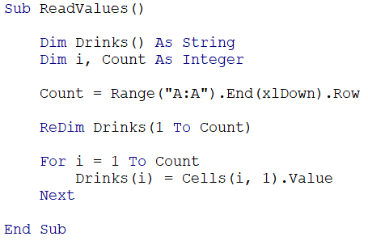
Exercise 3
Open IS_ExerciseQ3.xlsm. Write a macro and create a dynamic array. Use End(xlDown).Row to determine the number of elements needed in the array and store the values in Column A in the array.
Answer:

Slide 17
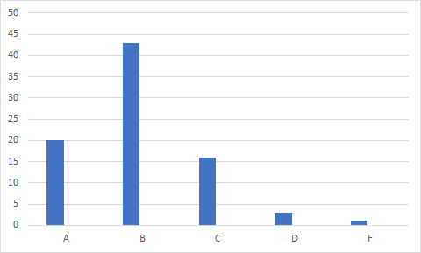
Plot graphs with array
We can also use arrays to plot charts.
Example: Use array to plot a bar chart of “No. of students” vs “Grade” for the data shown below.
Grade | No. of Students
A | 20
B | 43
C | 16
D | 3
F | 1

Slide 18
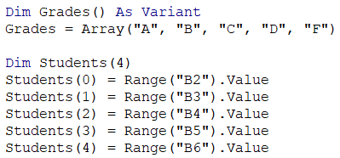
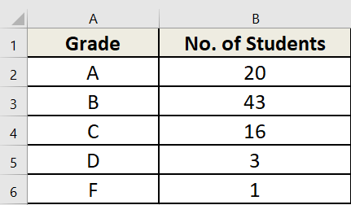

Do it with me
Step1: Create 2 arrays, one to store the grades and one to store the no. of students.
Step 2: Add these codes inside the sub to plot the bar chart.

